Slide 1

Operation Analytics and Investigating Metric Spike
By Indu Prakash

Slide 2
Case Study 1: Job Data Analysis
Jobs Reviewed Over Time
Throughput Analysis
Language Share Analysis
Duplicate Rows Detection

Slide 3
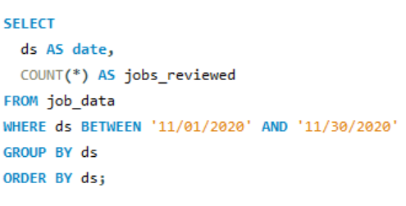
SQL query to calculate the number of jobs reviewed per hour for each day in November 2020.
A .Jobs Reviewed Over Time

Slide 4
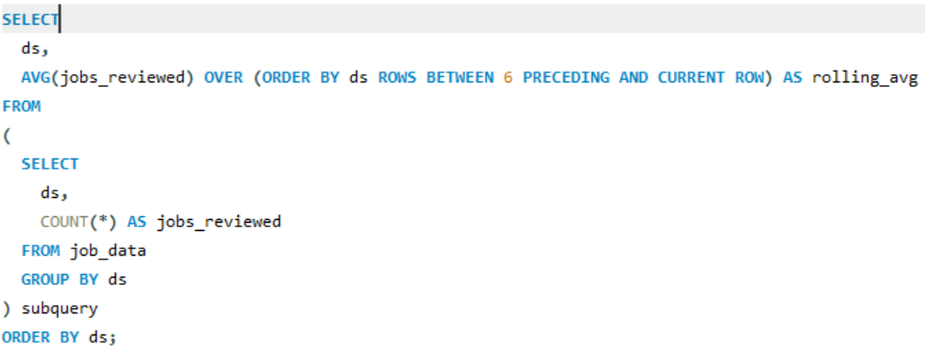
SQL query to calculate the 7-day rolling average of throughput.
B .Throughput Analysis

Slide 5
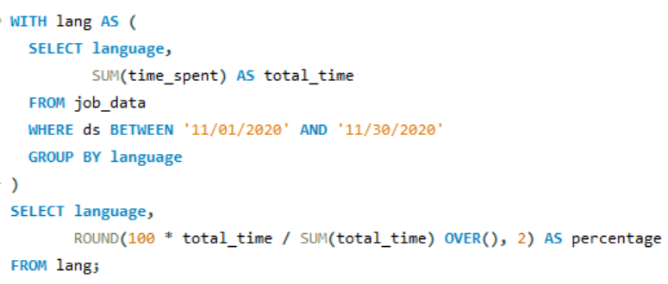
SQL query to calculate the percentage share of each language.
C. Language Share Analysis

Slide 6
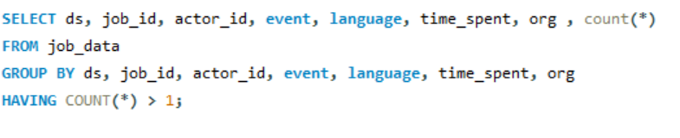
SQL query to display duplicate rows from the job_data table.
D. Duplicate Rows Detection

Slide 7
Case Study 2: Investigating Metric Spike
Weekly User Engagement
User Growth Analysis
Weekly Retention Analysis
Weekly Engagement Per Device
Email Engagement Analysis

Slide 8
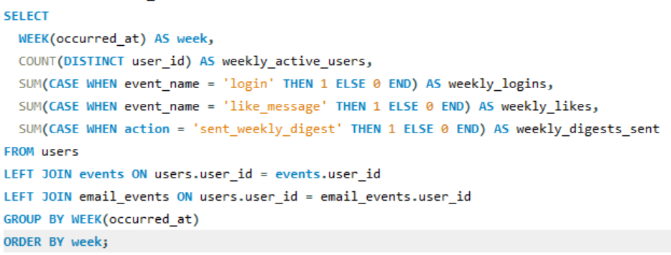
SQL query to calculate the weekly user engagement.
Weekly User Engagement

Slide 9
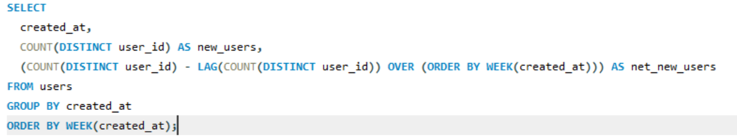
SQL query to calculate the user growth for the product.
B. User Growth Analysis

Slide 10
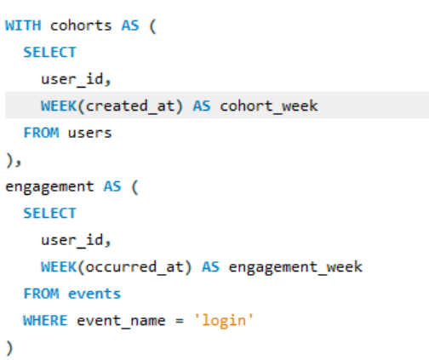
SQL query to calculate the weekly retention of users based on their sign-up cohort.
C. Weekly Retention Analysis

Slide 11
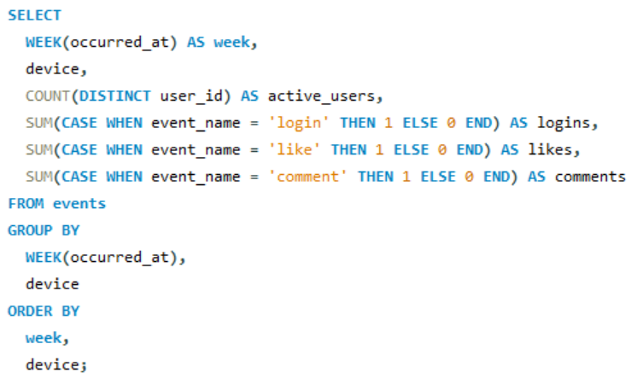
SQL query to calculate the weekly engagement per device.
D. Weekly Engagement Per Device

Slide 12
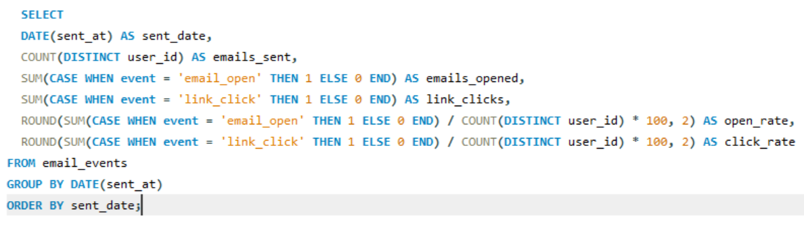
SQL query to calculate the email engagement metrics.
E. Email Engagement Analysis

